Slide 1
Friends

Slide 2
this Pointer
Every object of a class maintains a (hidden) pointer to itself called this
this is a reserved word
When an object invokes a member function
  the this pointer is referenced by the member function

Slide 3
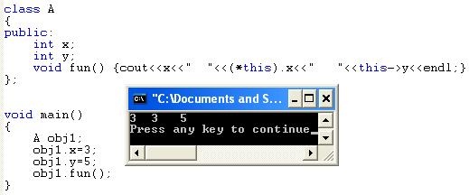
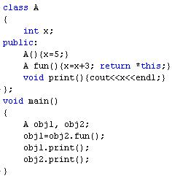
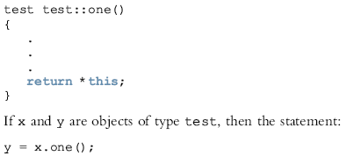
this Pointer
Copies the value of object x into object y
8
8

Slide 4
Friend Functions of Classes
A friend function of a class is a nonmember function of the class, but has access to all the members (public or non-public) of the class.
To make a function friend to a class
  The reserved word friend precedes the function prototype in the class definition

Slide 5
Friend Functions of Classes (continued)
The word friend appears only in the function prototype (in the class definition), not in the definition of the friend function
When writing the friend function definition
  The name of the class and the scope resolution operator are not used

Slide 6
Example
class Employee
{
private:
string name;
double salary;
public:
Employee();
Employee(string n, double s);
string getName();
double getSalary();
void raiseSalary(double amount, Employee& e);
};
Employee::Employee() : name(""), salary(0) {}
Employee::Employee(string n, double s): name(n), salary(s) {}
string Employee::getName() { return name; }
double Employee::getSalary() { return salary; }
void raiseSalary(double amount, Employee& e)
{
e.salary += amount;
}
Cannot access private member of Employee

Slide 7
Example
class Employee
{
private:
string name;
double salary;
public:
Employee();
Employee(string n, double s);
string getName();
double getSalary();
};
Employee::Employee() : name(""), salary(0) {}
Employee::Employee(string n, double s): name(n), salary(s) {}
string Employee::getName() { return name; }
double Employee::getSalary() { return salary; }
friend void raiseSalary(double amount, Employee& e);
void raiseSalary(double amount, Employee& e)
{
e.salary += amount;
}
Can now access private members of Employee

Slide 8
Friend Functions & Inheritance
class A
{
friend void func1();
int x;
};
class B: public A
{
friend void func2();
int y;
};
void func1()
{
B obj;
obj.x = 1;
//obj.y = 2 cannot access, not a friend of B
}
void func2()
{
B obj;
//obj.x = 1; cannot access, not a friend of A
obj.y = 2;
}

Slide 9
Friend Classes
A friend class is a class that can access the private and protected members of a class in which it is declared as friend.
This is needed when we want to allow a particular class to access the private and protected members of a class.

Slide 10

#include <iostream>
class A {
private:
int a;
public:
A() { a = 0; }
friend class B; // Friend Class
};
class B {
private:
int b;
public:
void showA(A& x)
{
// Since B is friend of A, it can access
// private members of A
std::cout << "A::a=" << x.a;
}
};
int main()
{
A a;
B b;
b.showA(a);
return 0;
}

Slide 11
Example
class Boss
{
public:
Boss();
void giveRaise(double amount, Employee& e);
};
Boss::Boss() {}
void Boss::giveRaise(double amount, Employee& e)
{
e.salary += amount;
}
class Employee
{
private:
string name;
double salary;
public:
Employee();
Employee(string n, double s);
string getName();
double getSalary();
};
Employee::Employee() : name(""), salary(0) {}
Employee::Employee(string n, double s): name(n), salary(s) {}
string Employee::getName() { return name; }
double Employee::getSalary() { return salary; }
Cannot access, private member of Employee

Slide 12
Example
class Boss
{
public:
Boss();
void giveRaise(double amount, Employee& e);
};
Boss::Boss() {}
void Boss::giveRaise(double amount, Employee& e)
{
e.salary += amount;
}
class Employee
{
private:
string name;
double salary;
public:
Employee();
Employee(string n, double s);
string getName();
double getSalary();
};
Employee::Employee() : name(""), salary(0) {}
Employee::Employee(string n, double s): name(n), salary(s) {}
string Employee::getName() { return name; }
double Employee::getSalary() { return salary; }
Can access private and protected members of Employee
friend class Boss;

Slide 13
some important points about friend functions and classes:
Following are some important points about friend functions and classes:
1) Friends should be used only for limited purpose. too many functions or external classes are declared as friends of a class with protected or private data, it lessens the value of encapsulation of separate classes in object-oriented programming.
2) Friendship is not mutual. If class A is a friend of B, then B doesn’t become a friend of A automatically.
3) Friendship is not inherited (See this for more details)
4) The concept of friends is not there in Java.

Slide 14
Thanks

